Slide 1
NSL Sugars Limited, Unit-III, Jay Mahesh

Slide 2
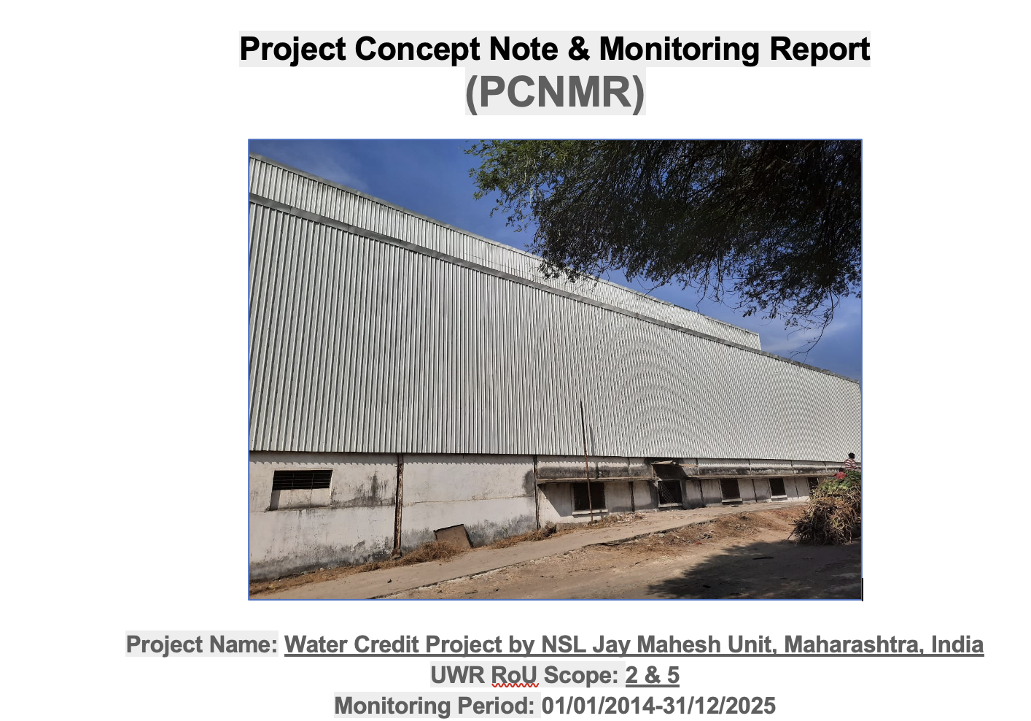

UWR Basic Details

Slide 3
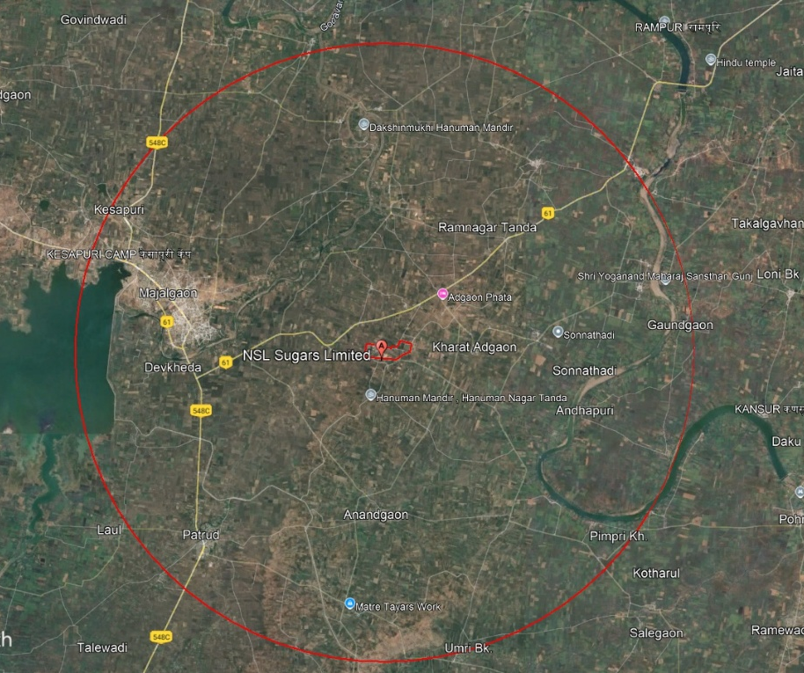
Picture 1: Location of Jay Mahesh Unit

Slide 4
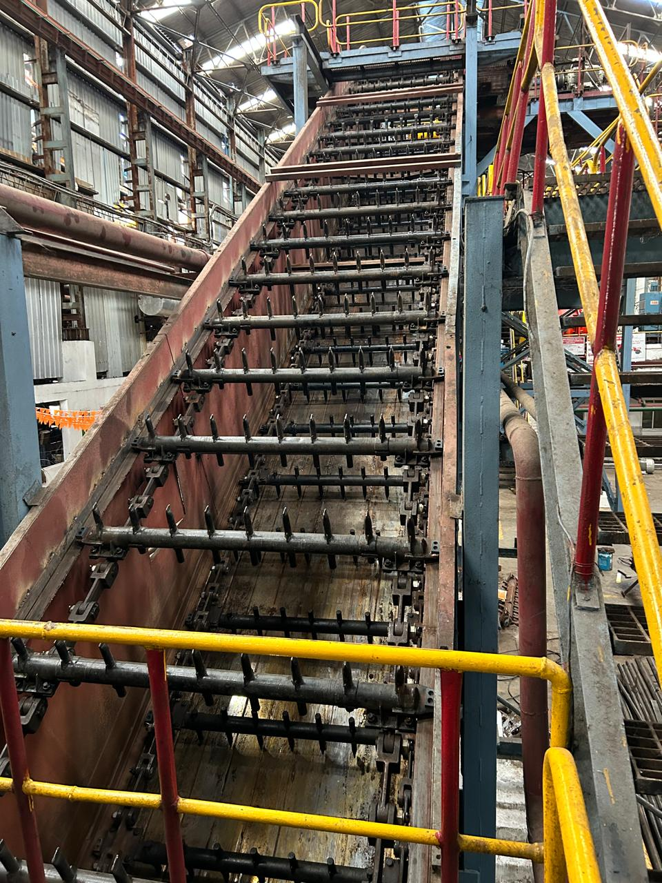
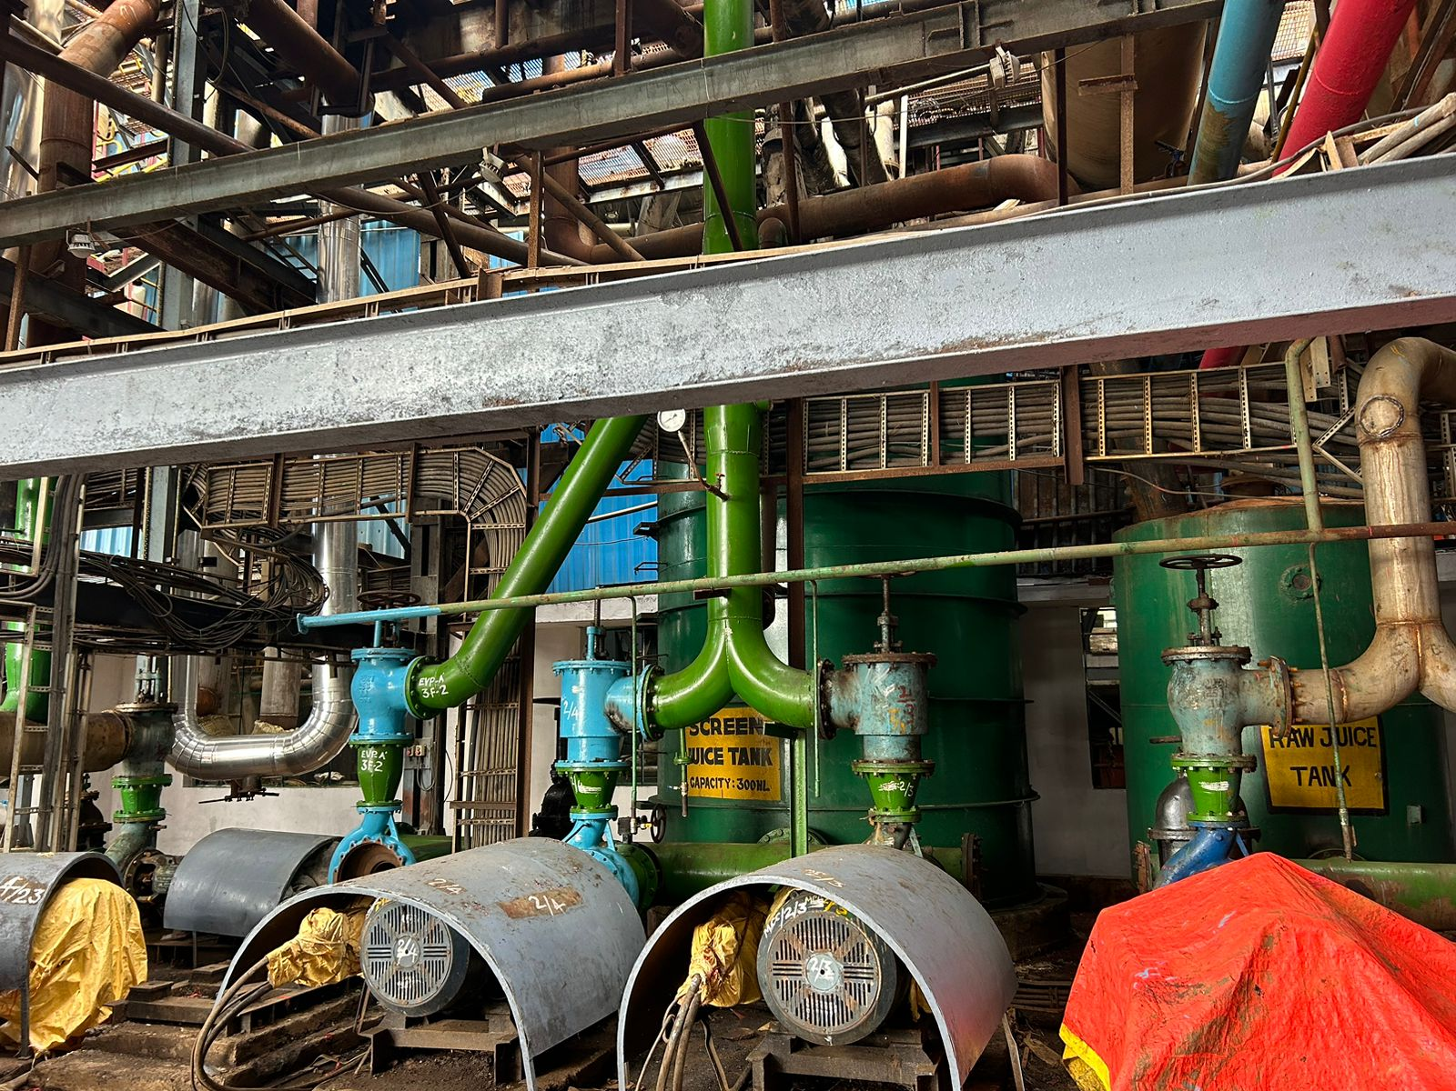
Picture 2 (a) : Cane crushing sections & Picture 2 (b) Sugar processing section of Jay Mahesh Unit

Slide 5
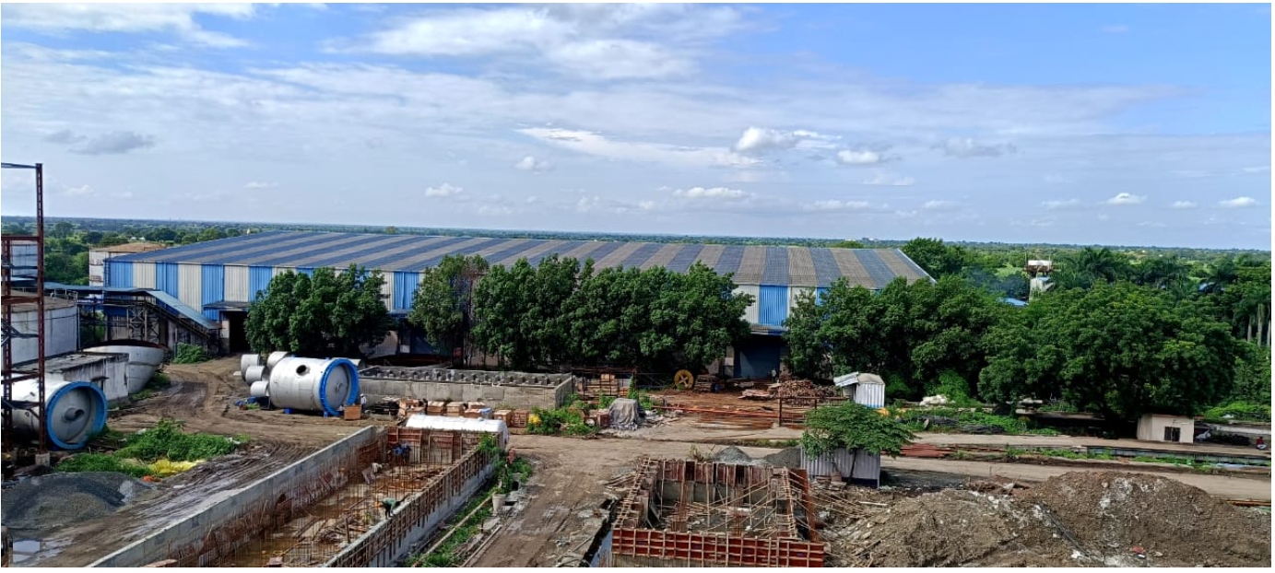
Picture 3: Sugar Godown

Slide 6
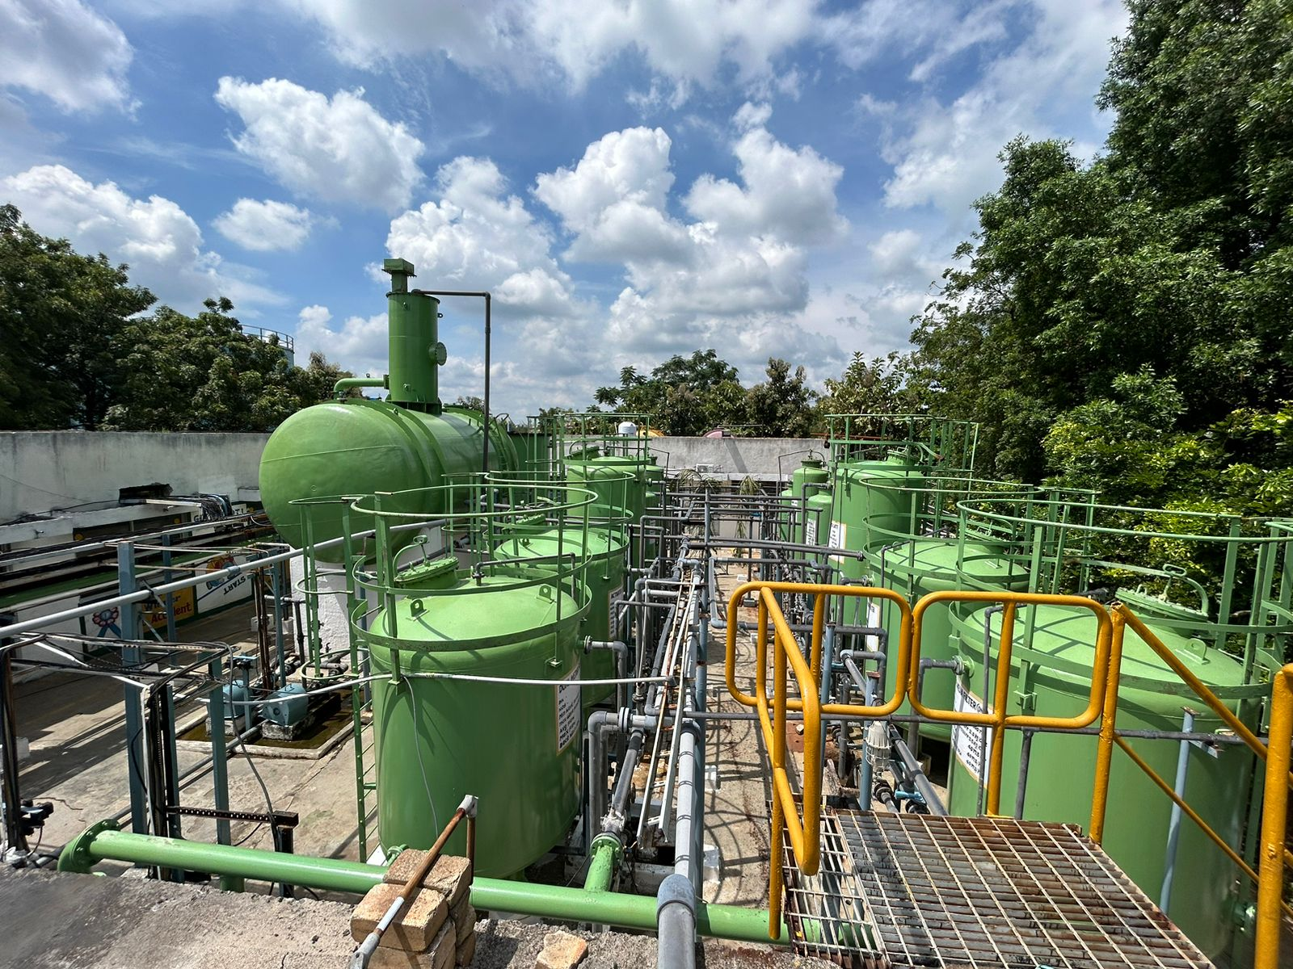
Picture 4: Water treatment plant

Slide 7
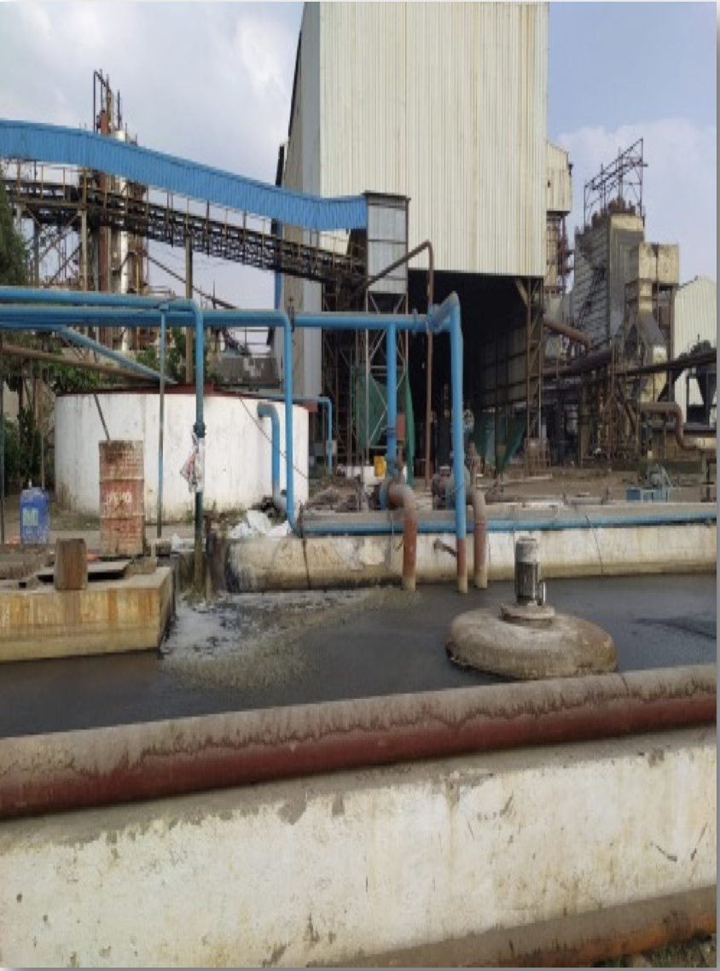
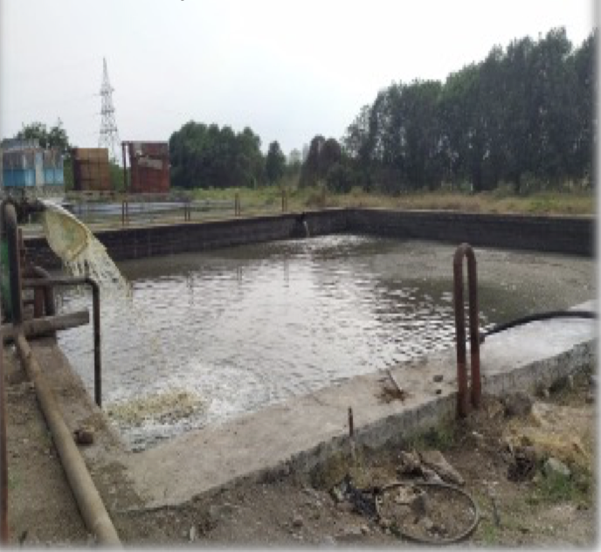
Picture 5: (a) Equalization Tank and (b) Buffer Tank installed at Jay Mahesh Unit

Slide 8
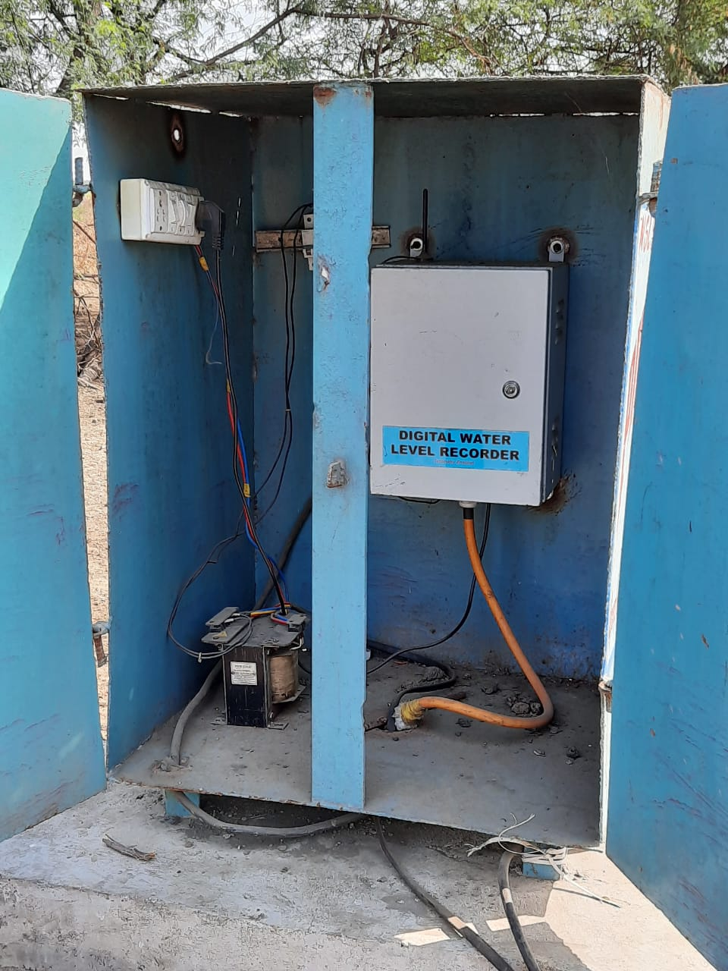
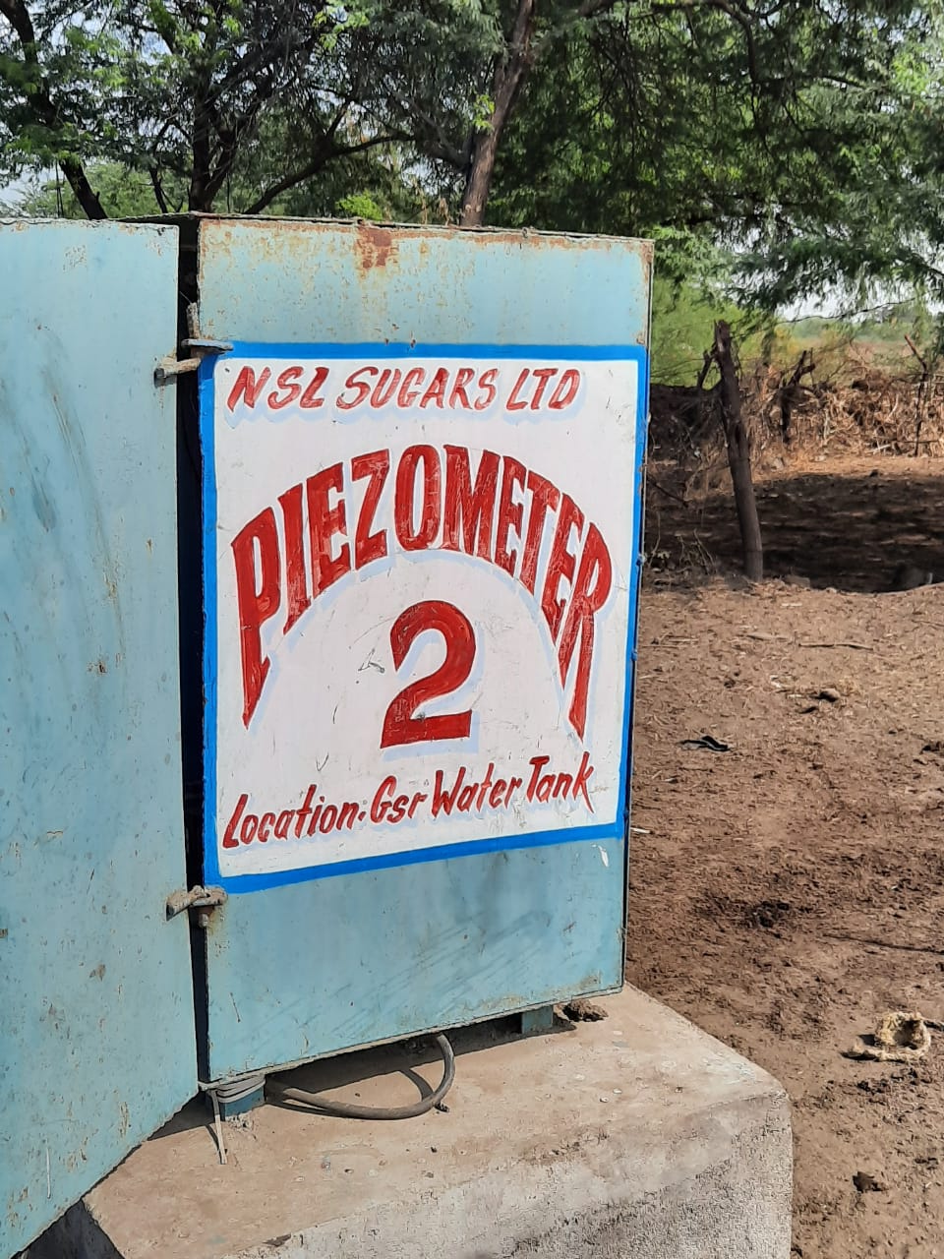
Picture 6: Piezometers installed at NSL Sugars Jay Mahesh Unit

Slide 9
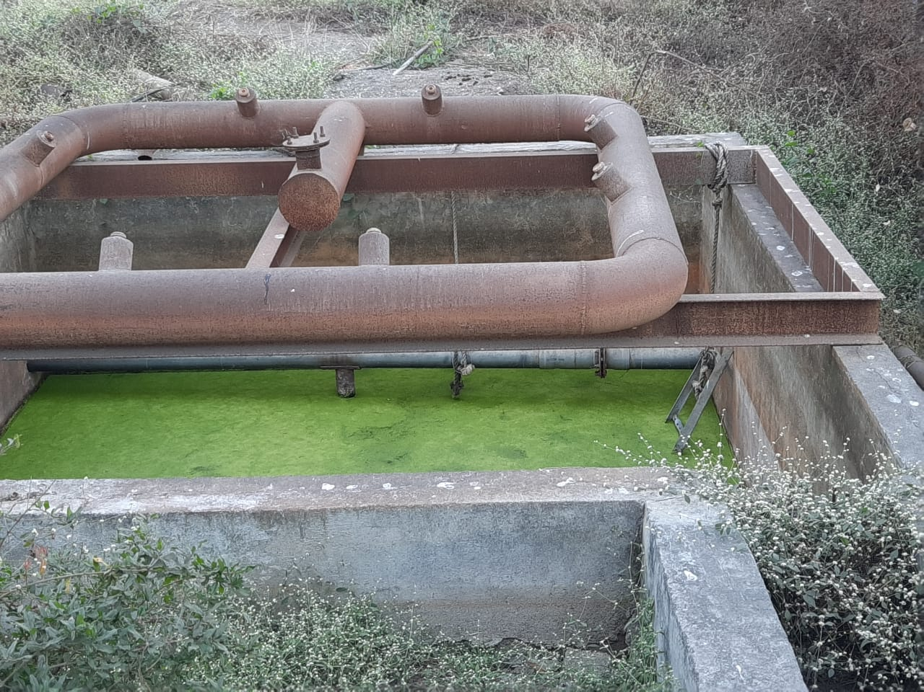
Picture 7: (a) Rainwater Collection Tank

Slide 10
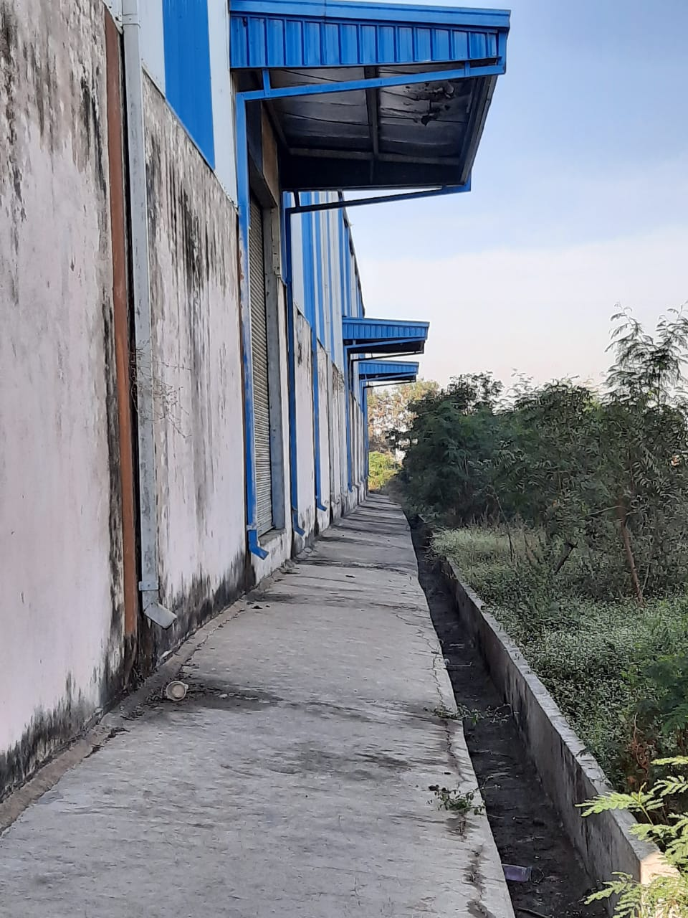
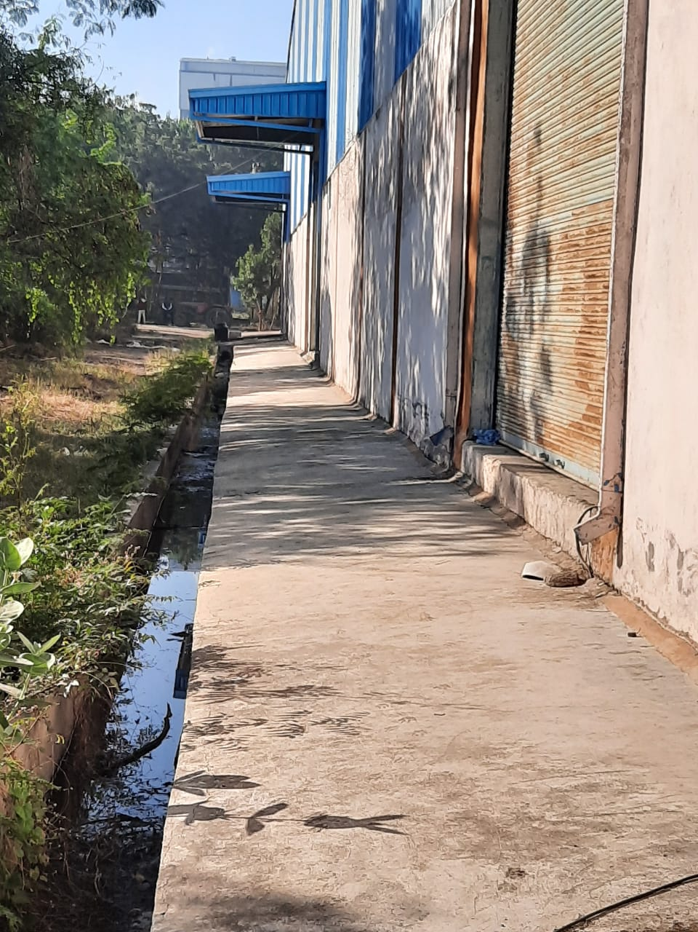
Picture 8: (a) & (b) Sugar Godown Rainwater drain Pipes at Jay Mahesh Unit

Slide 11
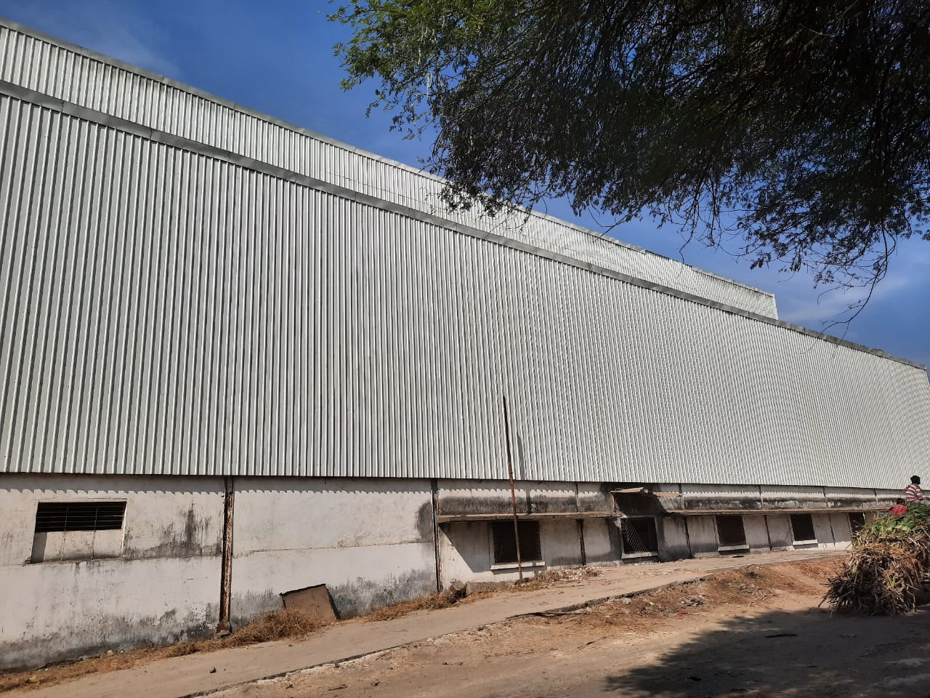
Rainwater Harvesting Unit
Picture 9: Mill Section Rainwater Collection System

Slide 12
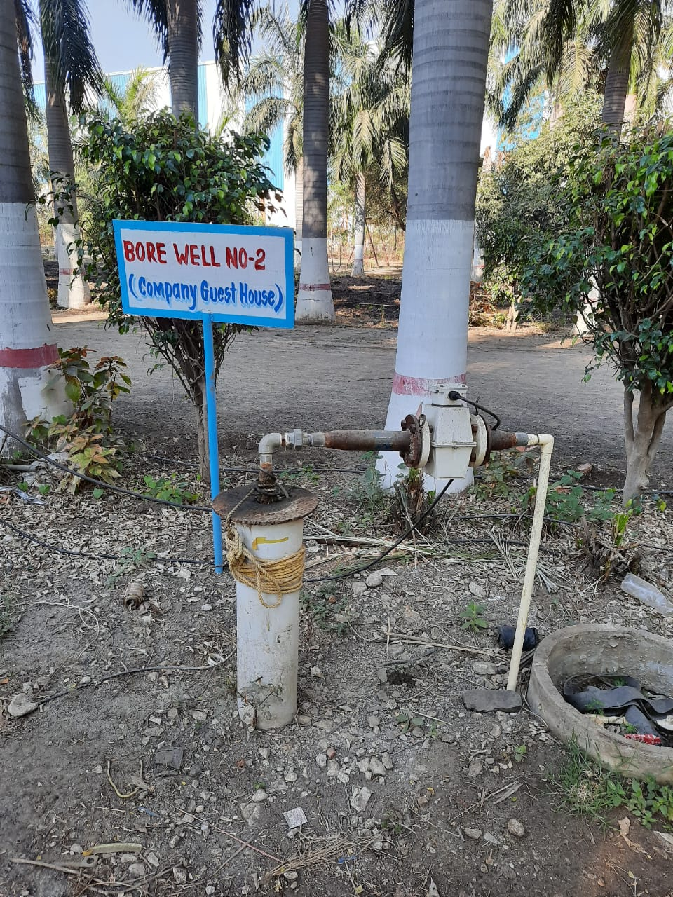
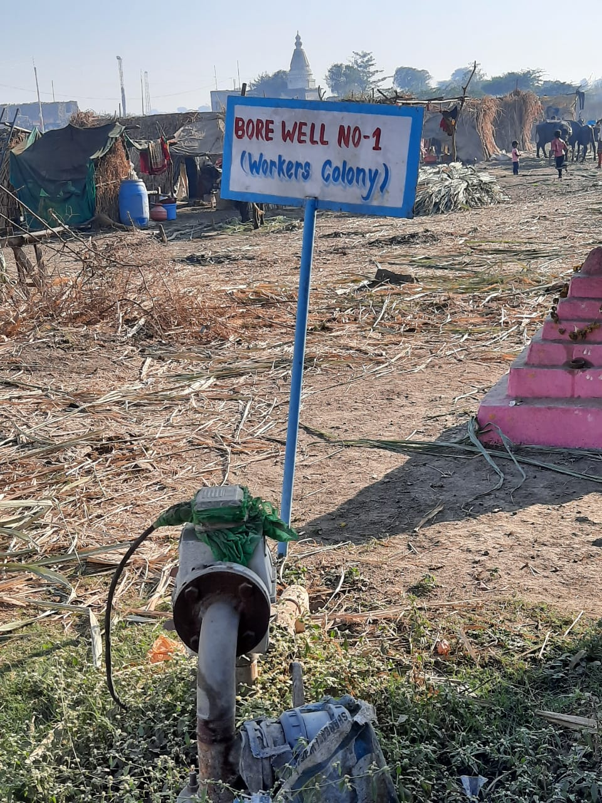
Picture 10: Bore wells installed in the Jay Mahesh Unit premises

Slide 13


